Slide 1


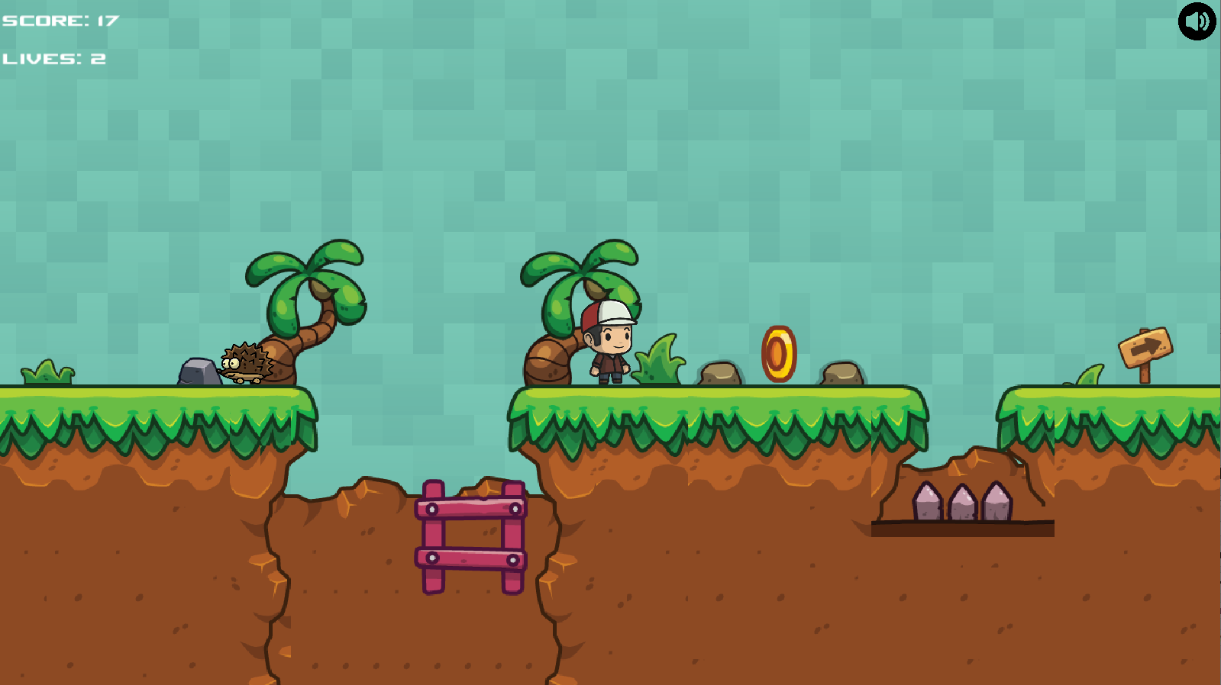
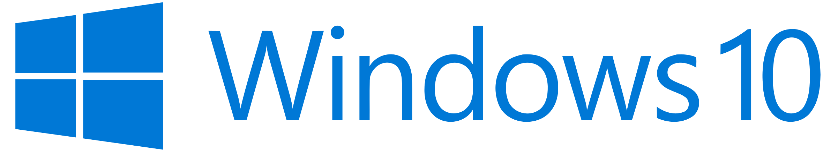

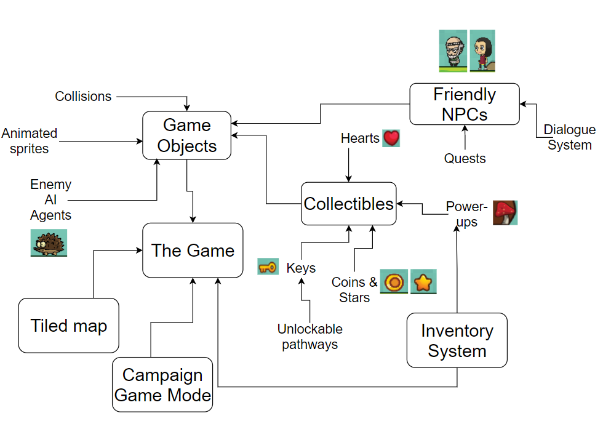
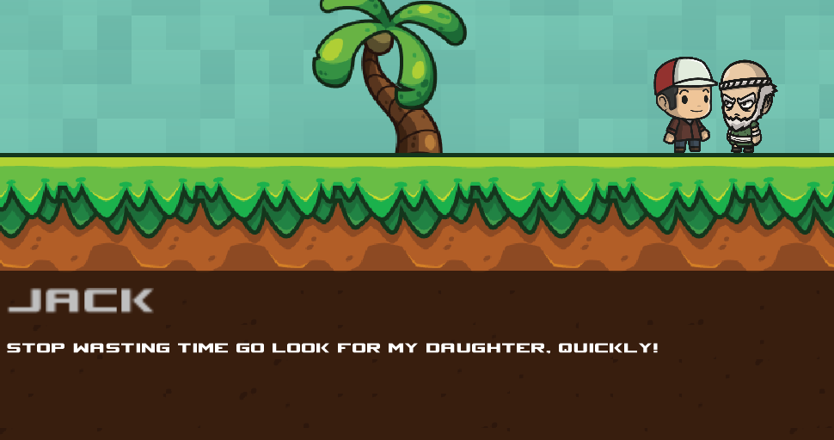
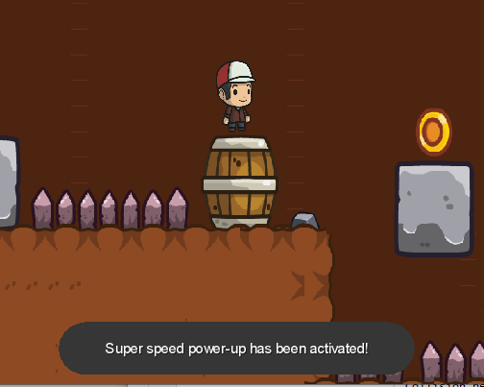




Recreate a classic arcade game
Bartosz Markiewicz Supervisor: Dr Faiyaz Doctor
What?
My project goals have been to create a side-scrolling 2D Mario game with lite RPG-elements such as friendly NPCs, a text based story narrative and a basic inventory system.
Technical Achievements
All moving objects are animated using my own animation code
Works on
Wide range of texture assets & sound effects employed.
Why?
When I was younger I enjoyed platformers such as Donkey Kong and Mario. Although my issue with these games was that they were too basic and were missing something. This had influenced me to to recreate the classic side-scrolling Super Mario Bros experience with my own twist on the formula.
Feature Diagram
Ongoing work
Release the game on the Android app store.
Online highscores saving using an SQL database.
More levels.
Endless ‘survival’ game-mode with an infinite procedureally generated map.
More types of and better enemy AI agents.
How?
Built on
Using
Notes:
aims and objectives, diagram of sorts for technical achievements, more visual description of tech achievements BREAK it down more, break it down into more sections, use symbols to show which tech I use.
Break down into points rather than big paragraphs

